Slide 1
546 HW2 report 14 marbles solitaire game
Zhenyan Liu

Slide 2
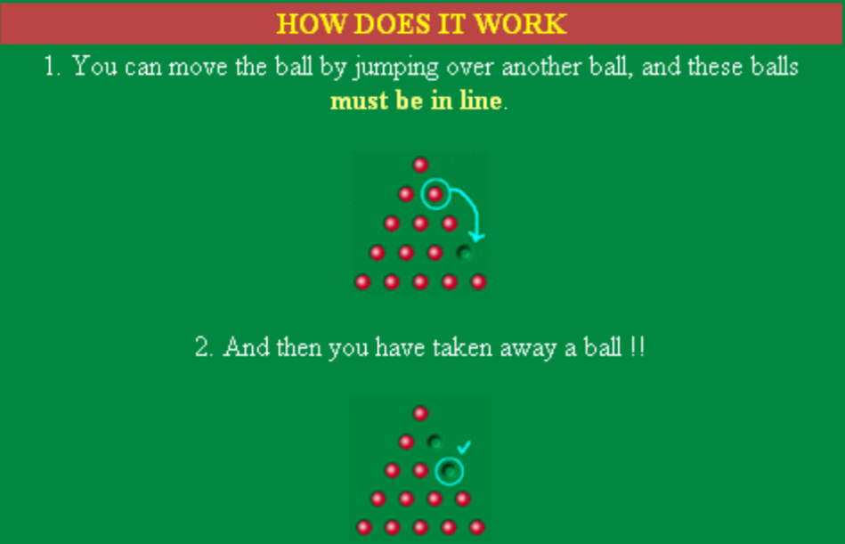
Rules for game:
Can jump diagonally or horizontally.

Slide 3
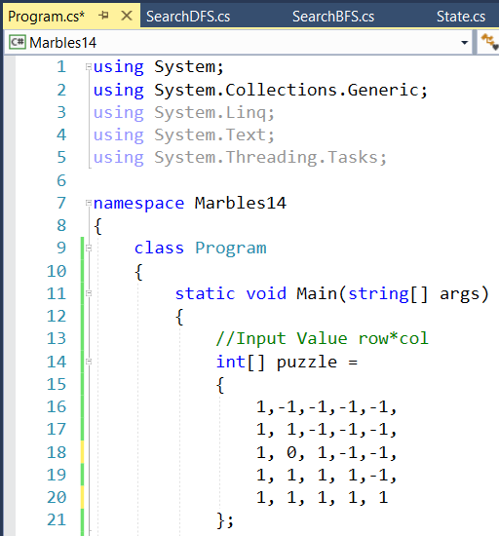
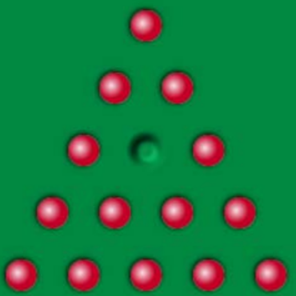

Marbles position in Code:
1---Marbles, 0---empty position,
-1----outside off game board
Output vs Input

Slide 4
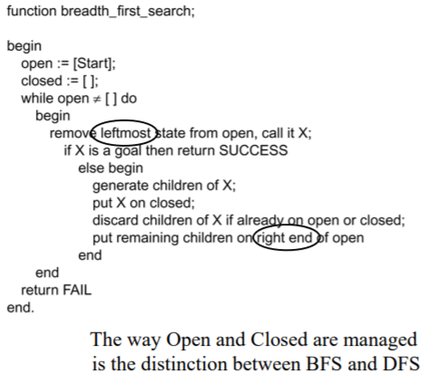
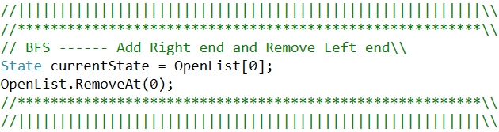
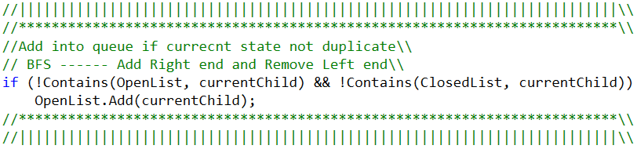
BFS method:
BFS Algorithm for lecture slide
BFS method in my code

Slide 5
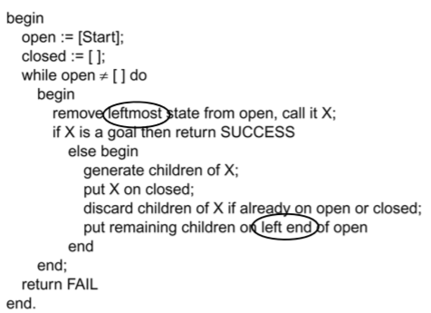
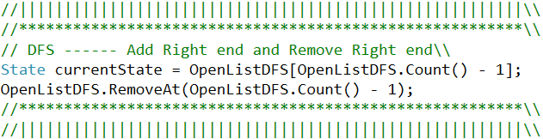
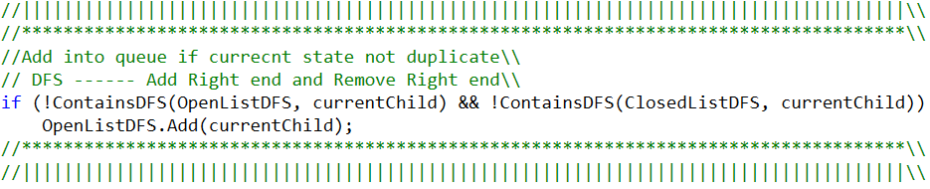
DFS method:
DFS Algorithm for lecture slide
DFS method in my code

Slide 6
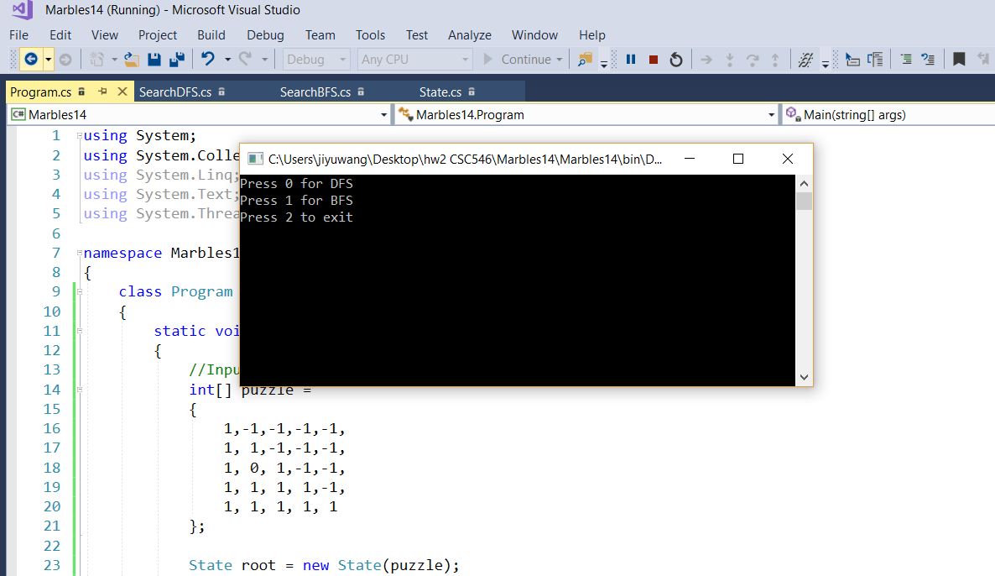
Running the code:
Press 0 : DFS
Press 1 : BFS
Press 2 : Exit

Slide 7





Test Case1: DFS

Slide 8





Test Case1: BFS

Slide 9
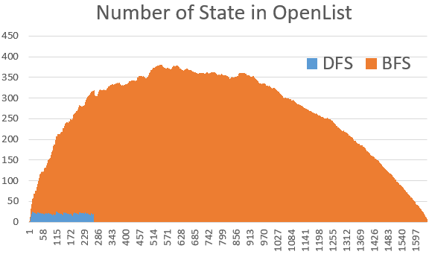
Test Case1: BFS vs DFS

Slide 10





Test Case2: DFS

Slide 11





Test Case2: BFS

Slide 12
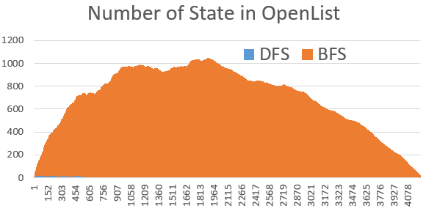
Test Case2: BFS vs DFS

Slide 13
Comments:
Both DFS and BFS applied in this 14 marbles game.
DFS is quicker than BFS in my test cases.
DFS occupies less memory than BFS.

